Slide 1
ARES EOG PARENT NIGHT 2023
May 16th, 2023

Slide 2
WHAT IS THE EOG?
END OF GRADE TEST
MANDATORY STATE ACHIEVEMENT TESTS
ADMINISTERED IN GRADES 3-5 FOR ELEMENTARY SCHOOLS
3RD & 4TH GRADERS TAKE READING AND MATH
5TH GRADERS TAKE READING, MATH, AND SCIENCE
PASSING SCORES ARE LEVELS III, IV, AND V IN BOTH READING AND MATH
NON-PASSING SCORES ARE LEVELS NON- PROFICIENT

Slide 3
ARES TESTING DATES
WHEN IS THE EOG?
Thursday, May 25th
Grade 3 Math EOG
Grade 4 Math EOG
Grade 5 Math EOG
Tuesday, May 30th
Grade 3 Reading EOG
Grade 5 Reading EOG
Thursday, June 1st
Grade 4 Reading EOG
Grade 5 Science EOG
Friday, June 2nd
Grade 3 Reading Retest
Wednesday, June 7th
Grade 3 Read to Achieve
VISION
There is always a testing window.
This will vary by school, but it will occur within the last 10 days of the school year. Our testing window begins Thursday May 25th.

Slide 4
SCORING
Grade Level Proficiency refers to whether or not students have met the criteria for their current grade and prepared for the next grade.
College and Career Ready is a relatively new measure of accountability that assists us in identifying students who are both prepared for the next grade and are career/college ready.

Slide 5
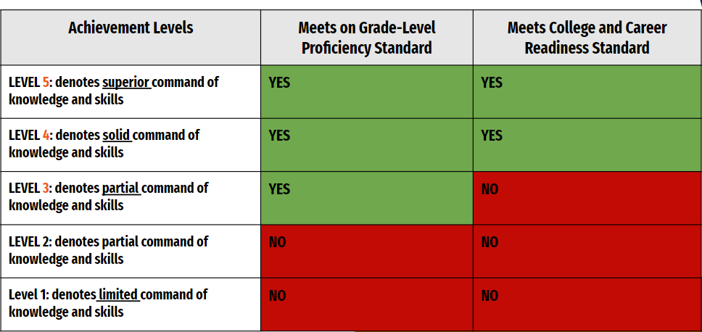
SCORING

Slide 6
ELA EOG

Slide 7
BREAKDOWN
48 MULTIPLE-CHOICE QUESTIONS
ONLINE FORMAT
STUDENTS READ AUTHENTIC SELECTIONS AND THEN ANSWER QUESTIONS RELATED TO THE SELECTIONS
THE READING SELECTIONS ARE COMPRISED OF LITERARY AND INFORMATIONAL TEXT BASED ON THE NC STATE STANDARDS
KNOWLEDGE OF VOCABULARY IS ASSESSED INDIRECTLY THROUGH THE APPLICATION AND UNDERSTANDING OF TERMS WITHIN THE CONTEXT OF THE SELECTIONS AND QUESTIONS

Slide 8
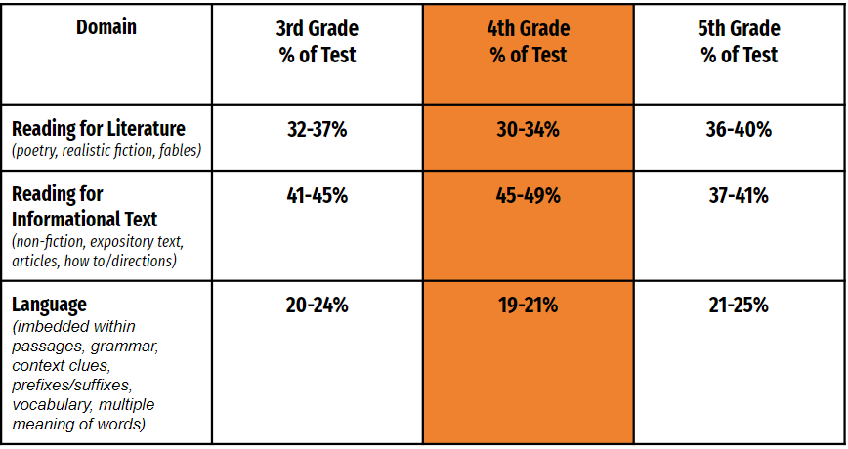
WEIGHT DISTRIBUTION

Slide 9
MATH EOG

Slide 10
BREAKDOWN
46 MULTIPLE-CHOICE QUESTIONS
ONLINE FORMAT
THE MATHEMATICS TEST WILL CONSIST OF TWO PARTS: CALCULATOR INACTIVE AND CALCULATOR ACTIVE.
STUDENTS ARE ALLOWED TO USE CALCULATORS DURING THE CALCULATOR ACTIVE PART OF THE TEST ONLY.

Slide 11
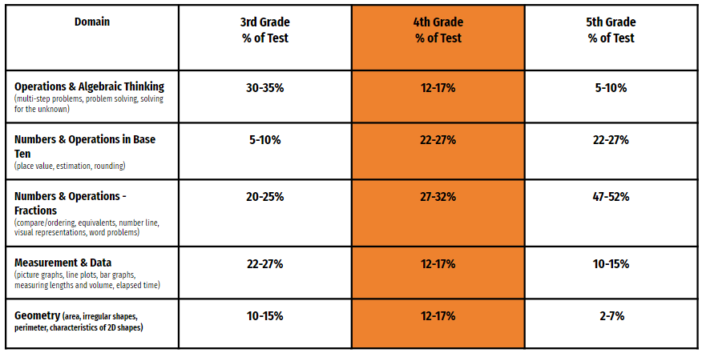
WEIGHT DISTRIBUTION

Slide 12
HOW ARE WE HELPING
Small group time with teachers or partners
WIN time based on specific skill needs
Practice EOG Selections
MOG EOG
Testing Strategies

Slide 13
HOW CAN YOU HELP?
Remind your student to take the test seriously. It is important they read the questions carefully and review each of the potential answers prior to making their selection. They should never leave an answer blank but should instead choose the best answer to the question.
Manage stress and anxiety. Take a “walk and talk” to reduce stress and open lines of communication. Give your child the opportunity to talk about his expectations, fears and hopes.
If your child feels anxious during the test, taking a few deep breaths might help ease their nerves. Practice ten deep breaths with them before they go to school.

Slide 14
HOW CAN YOU HELP?
START THE TESTING DAY IN A CALM WAY! ALLOW PLENTY OF TIME TO SAY A FEW ENCOURAGING WORDS, LET YOUR CHILD KNOW HOW MUCH YOU BELIEVE IN THEM.
Lastly, when the test is complete, your child should feel good about a job well done. Help them celebrate by spending special one on one time together.
Start the testing day in a calm way! Allow plenty of time to say a few encouraging words, let your child know how much you believe in them.

Slide 15
BEFORE THE TEST
THE WEEKS LEADING UP…
BUILD UP THEIR CONFIDENCE
HAVE STUDENTS READ A VARIETY OF MATERIALS TO HELP BUILD VOCABULARY (20 MINUTES A NIGHT)
THE NIGHT BEFORE…
GET A GREAT NIGHT’S SLEEP – AT LEAST 8 HOURS
LIMIT SCREEN TIME
HAVE OUTFIT PICKED OUT & READY TO GO
THE MORNING OF…
STRESS & DRAMA-FREE
GREAT BREAKFAST
ENCOURAGEMENT TO DO HIS/HER BEST
A “DO YOUR BEST & I BELIEVE IN YOU” HUG
ARRIVE ON TIME!!!

Slide 16
OTHER INFORMATION
NO CELL PHONES/SMART WATCHES IN THE TESTING SESSIONS
VOLUNTEERS NEEDED! (TO BE PROCTORS FOR THE EOG TEST DAYS) Please contact Mrs. Espinoza if interested!
https://www.dpi.nc.gov/districts-schools/testing-and-school-accountability/state-tests/end-grade-eog

